Slide 1
Comp Photography (Fall 2015)
HW 10
Hieu Nguyen
Computational Photography @ GT

Slide 2
Describe the Sites you chose
Site 1: Photosynth of the Austin city skyline from Zilker Park
Panoramic views taken with a drone camera.
Site 2: Panorama taken at Doug Sahm Hill
A scenic hilltop in a park near downtown Austin.
Site 3: Wall Photosynth of the HOPE Outdoor Gallery
A collection of graffiti wall art in a residential area.
Site 4: Walk Photosynth at Mount Bonnell
A dronie (drone selfie) at the highest point in Austin.
Computational Photography @ GT

Slide 3
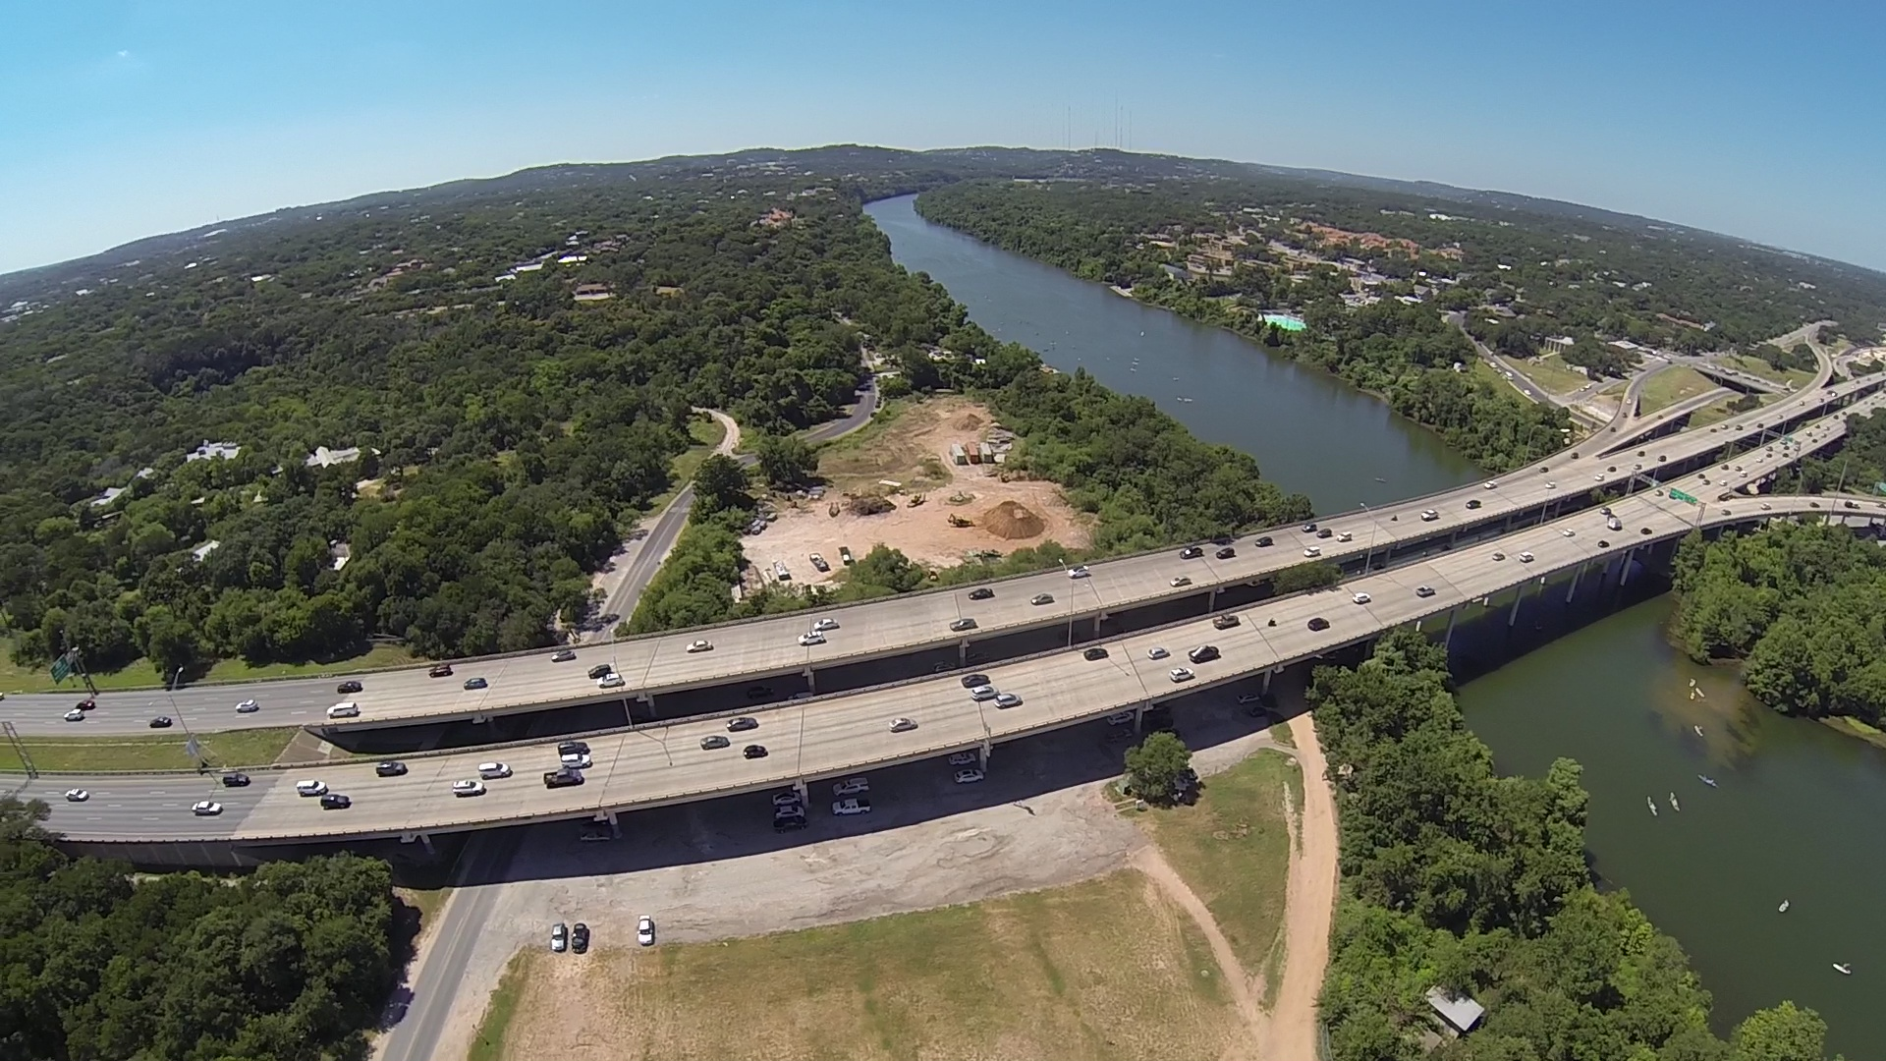
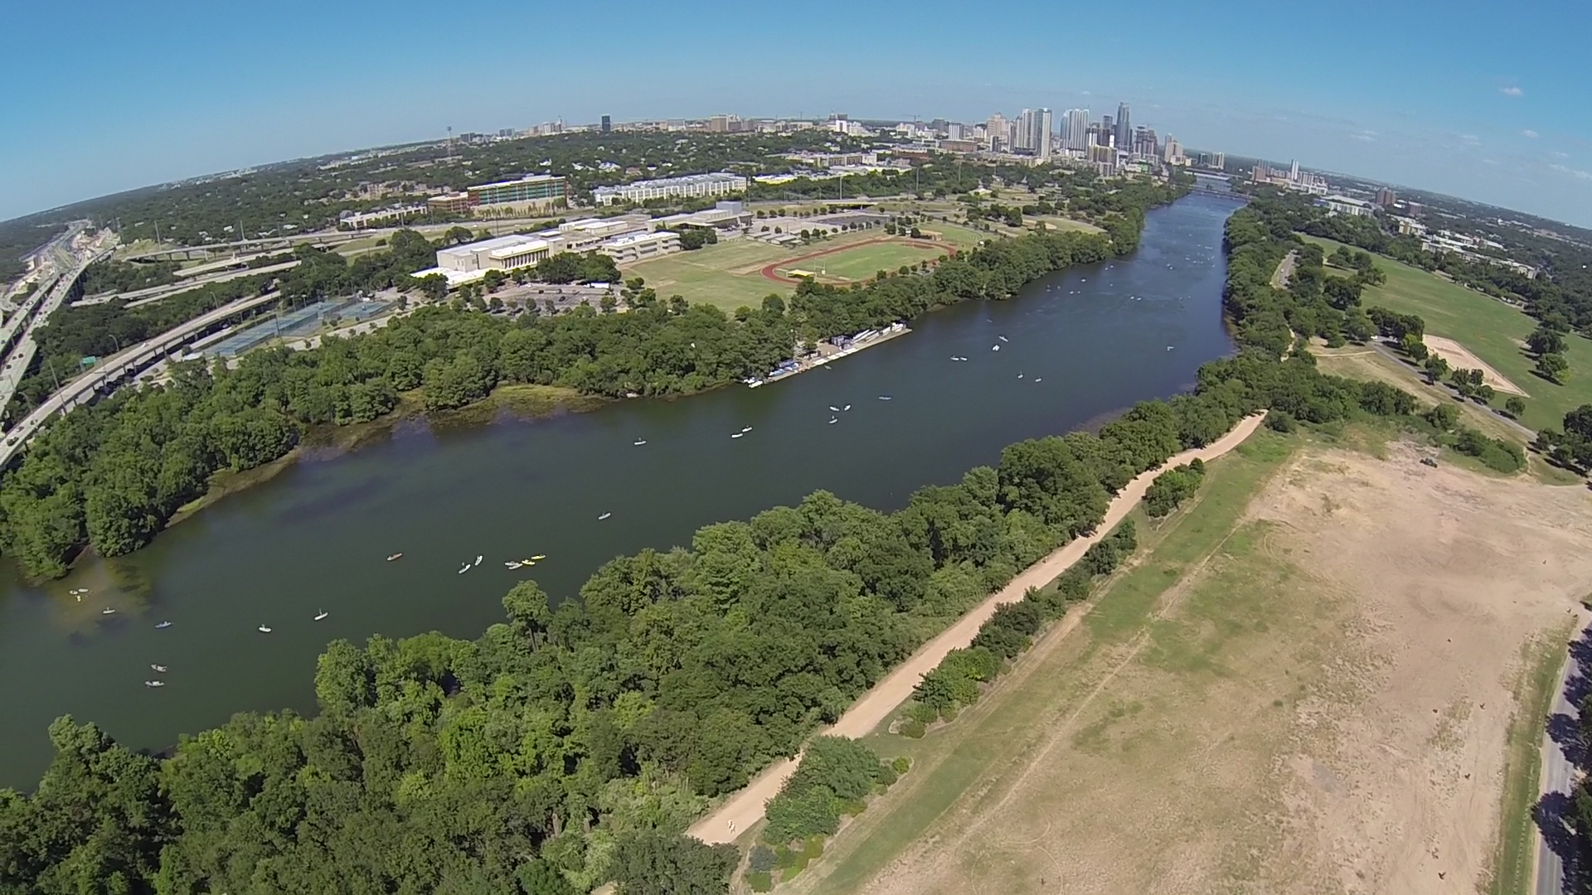
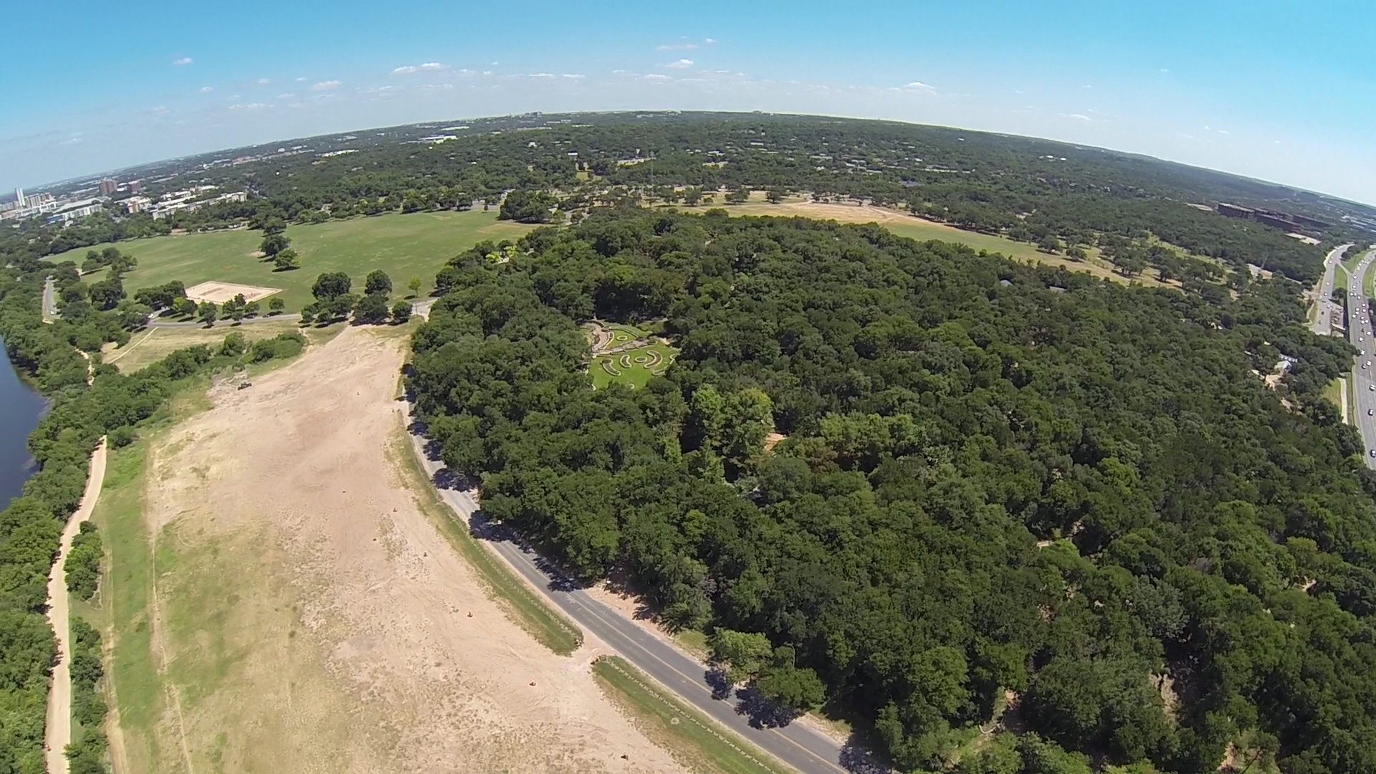
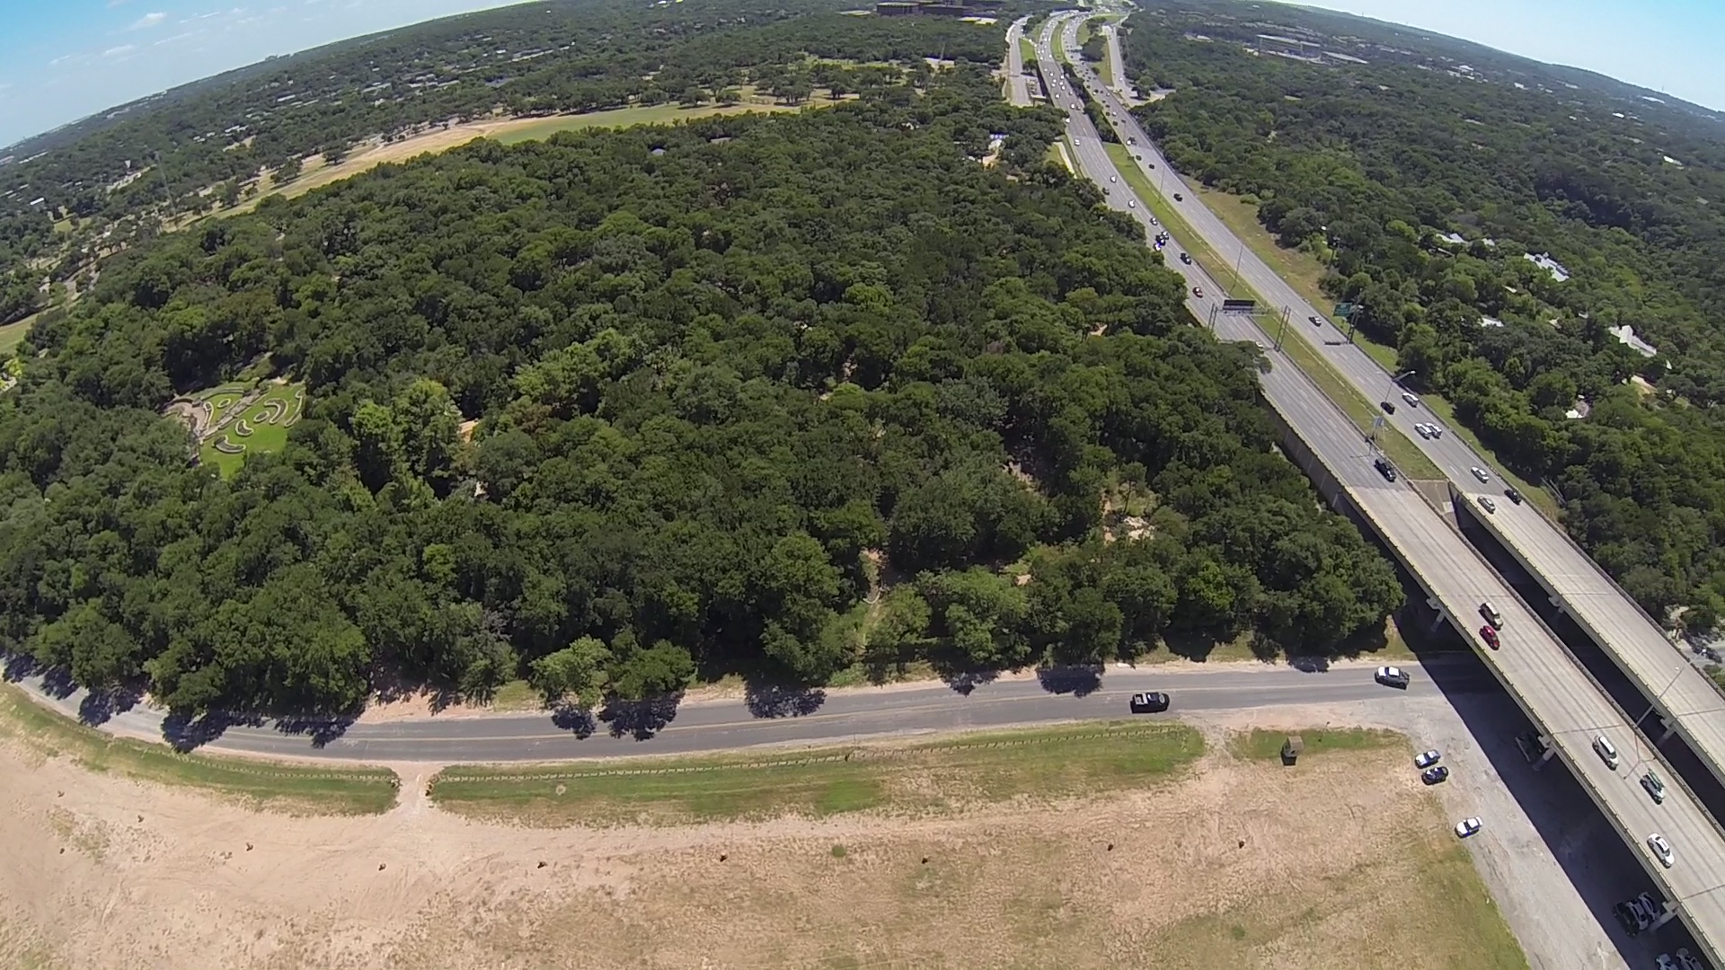
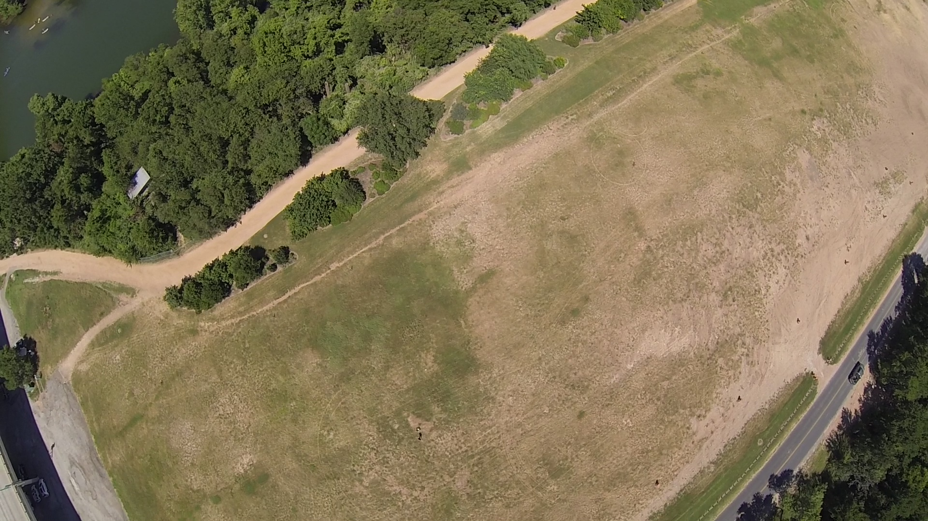
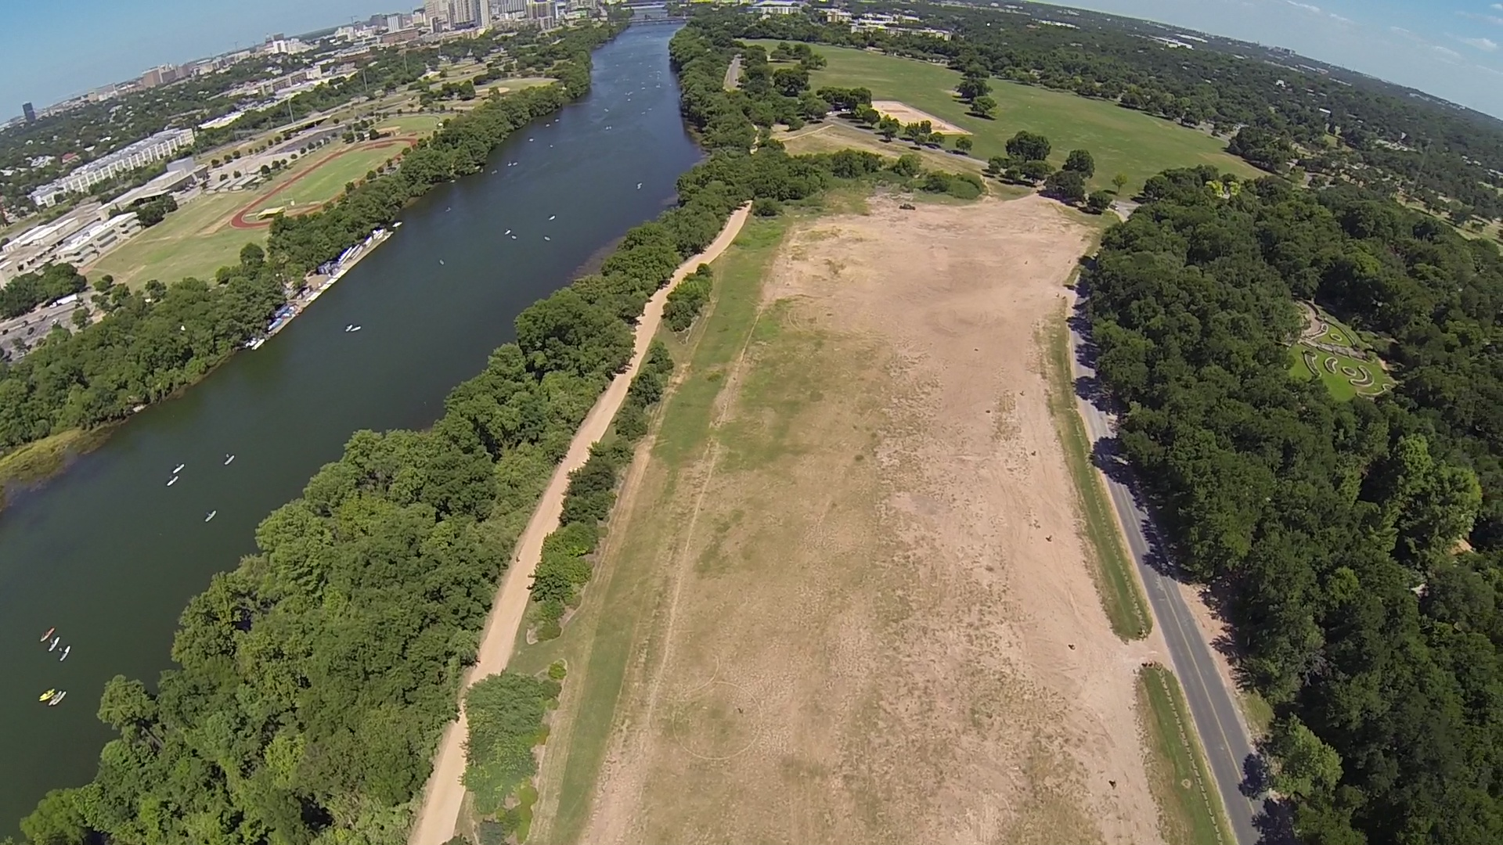
Site 1: Photosynth of Austin Skyline
This (old/legacy) photosynth consisted of 29 photographs.
Computational Photography @ GT

Slide 4
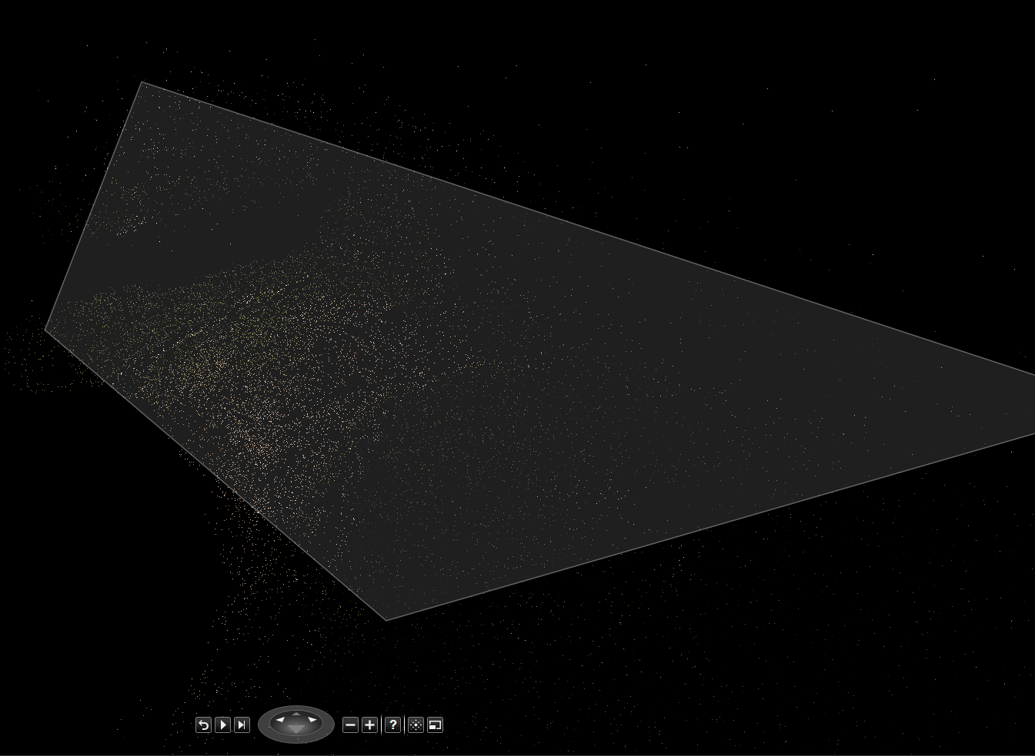
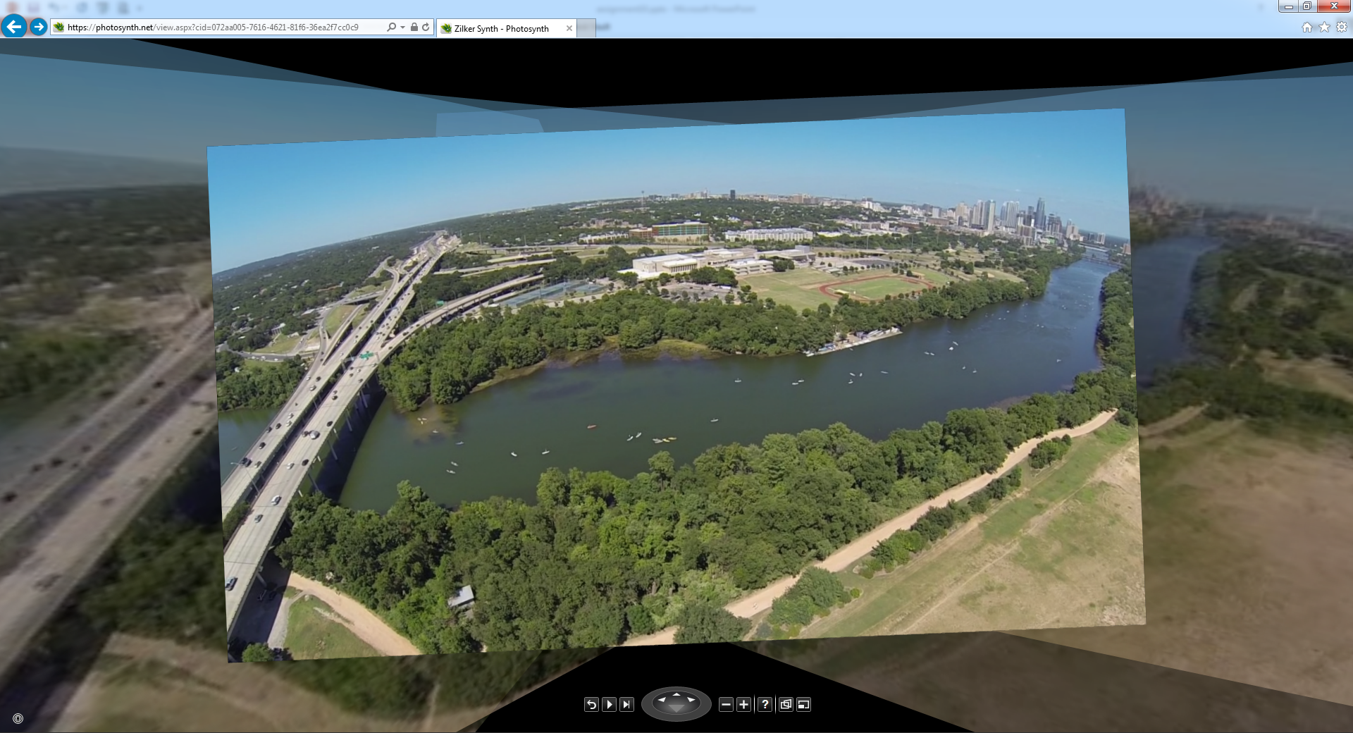
Site 1: Photosynth of Austin Skyline
Photosynth: https://photosynth.net/view.aspx?cid=072aa005-7616-4621-81f6-36ea2f7cc0c9
Computational Photography @ GT

Slide 5
Site 1: Details
I generated this photosynth using Microsoft’s desktop application. The 29 input images were taken with a GoPro camera mounted on a drone, approximately 75m above ground level. The panoramic scene was captured by adjusting the drone’s yaw a full 360 degrees. I was also able to capture a little more of the scene by tilting the camera gimbal. The resulting 3D point cloud was able to detect a wide distribution of points in the space.
What would you do differently?
Next time, I’d like to capture even more of the scene to resemble a complete photosphere.
Computational Photography @ GT

Slide 6
Site 2: Panorama at Doug Sahm Hill
How many photographs? 23 photographs
How much of a FOV change was this? ~15° FOV change
What kind of a Panorama is this? 360° Rotational
What software did you use? Microsoft ICE and Photosynth
Computational Photography @ GT

Slide 7
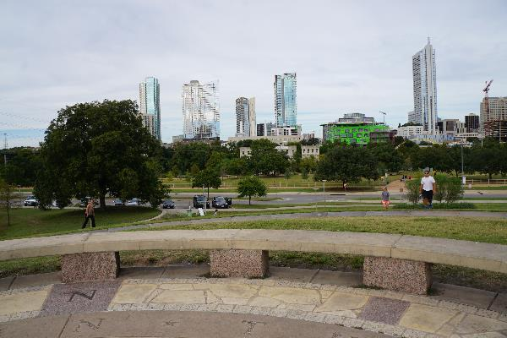
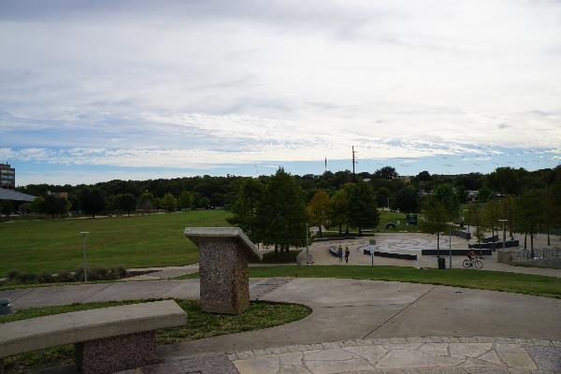
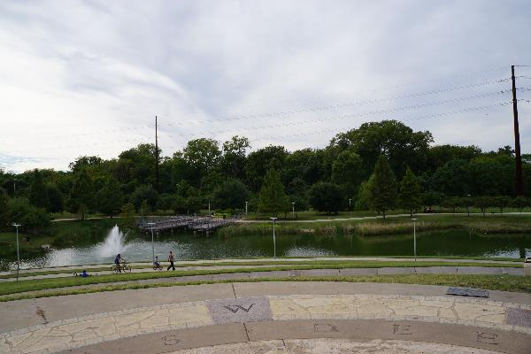
Site 2: Panorama Input
Computational Photography @ GT

Slide 8
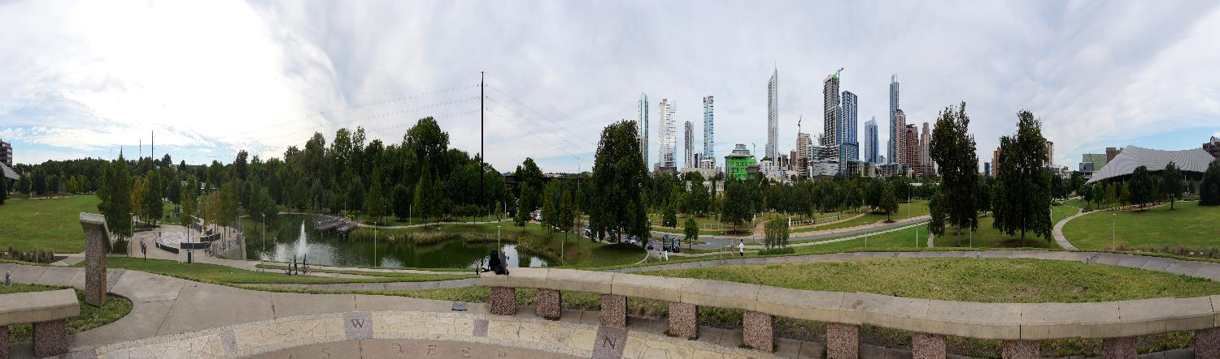
Site 2: Panorama Output (aspect ratio not preserved)
High res: https://drive.google.com/file/d/0B-9-oKYR8vK2dG16QmlJN2tGekE/view?usp=sharing
Photosynth: https://photosynth.net/view.aspx?cid=145bf411-bc03-42f6-ade2-9feeb05889f3
Photosynth 3D: https://photosynth.net/preview/view/ac66ea6f-e3e2-4dcc-90fa-7f15ad819541
Computational Photography @ GT

Slide 9
Site 2: Details
This panorama was created using Microsoft’s Image Composite Editor. It easily took care of image warping, alignment, and stitching. The 23 input images were taken using a tripod and rotating in place at ~15 degree step sizes. The result is a neat panorama that shows both city and green space in a large field of view.
What would you do differently?
Next time, I’d like to adjust the subject framing (less sky, more interesting ground) to create a more artistic result.
Computational Photography @ GT

Slide 10
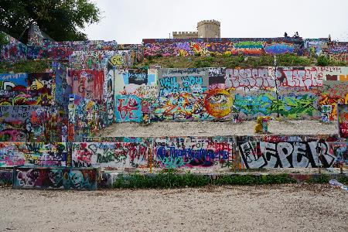
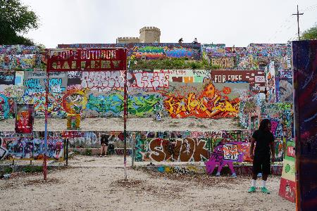
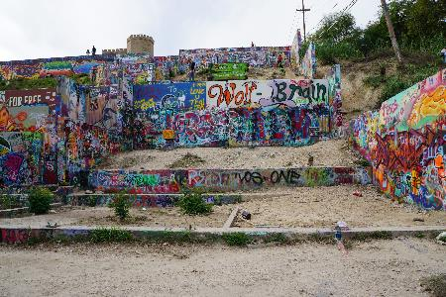
Site 3: Photosynth of HOPE Outdoor Gallery
This wall photosynth consisted of 21 photographs.
Computational Photography @ GT

Slide 11
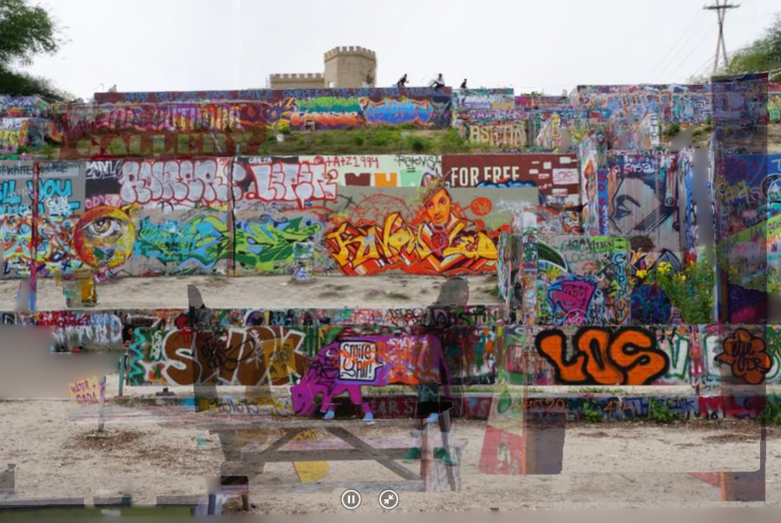
Site 3: Photosynth of HOPE Outdoor Gallery
Photosynth 3D: https://photosynth.net/preview/view/e905a76e-77e6-4eba-b9d8-c4980d1888e6
Computational Photography @ GT

Slide 12
Site 3: Details
This wall photosynth was generated using the Photosynth 3D preview. I captured the scene by taking a planar panorama. The resulting photosynth animation creates a cool 3D effect because there is a lot of depth in the scene. The wall structures, colorful murals, and dynamic human subjects create a mesmerizing portrayal of the scene.
What would you do differently?
Next time, I’d work on focusing in on specific murals. This would add another dimension to the photosynth and help with artifacts and occlusions.
Computational Photography @ GT

Slide 13
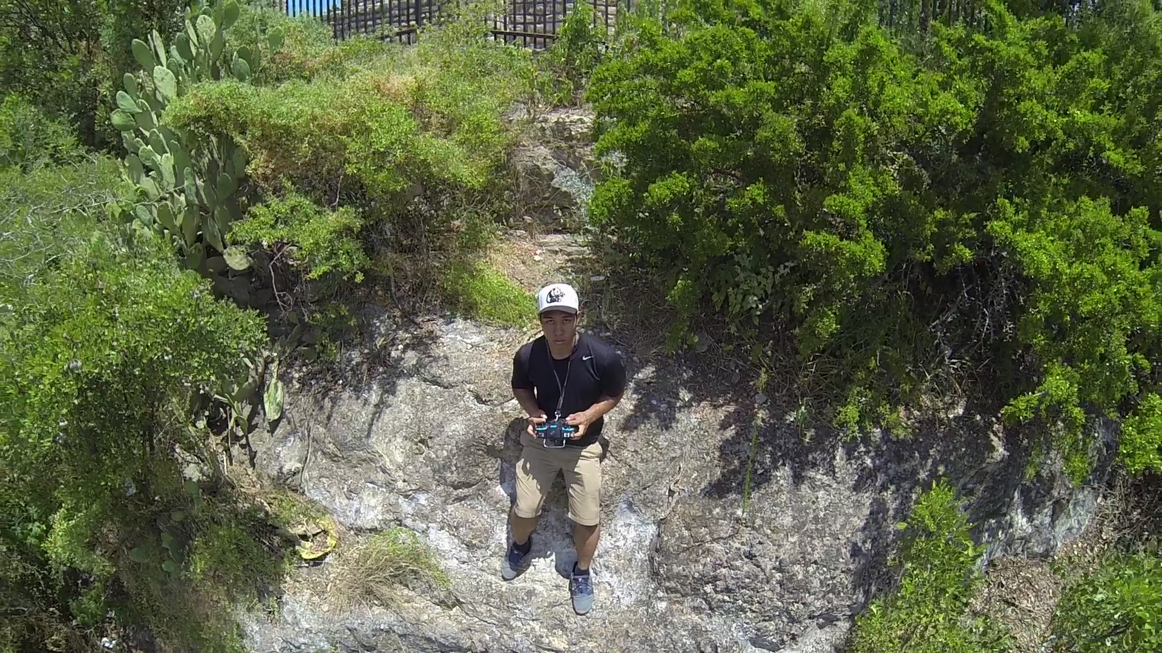
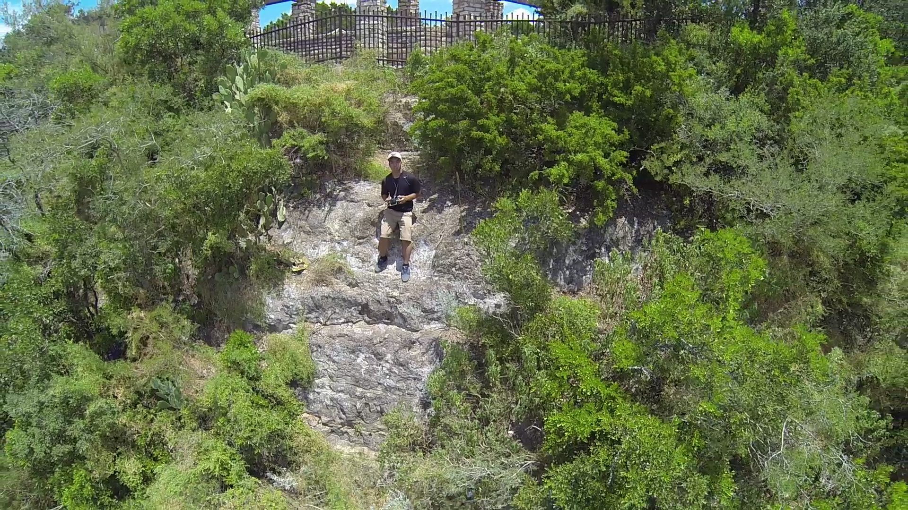
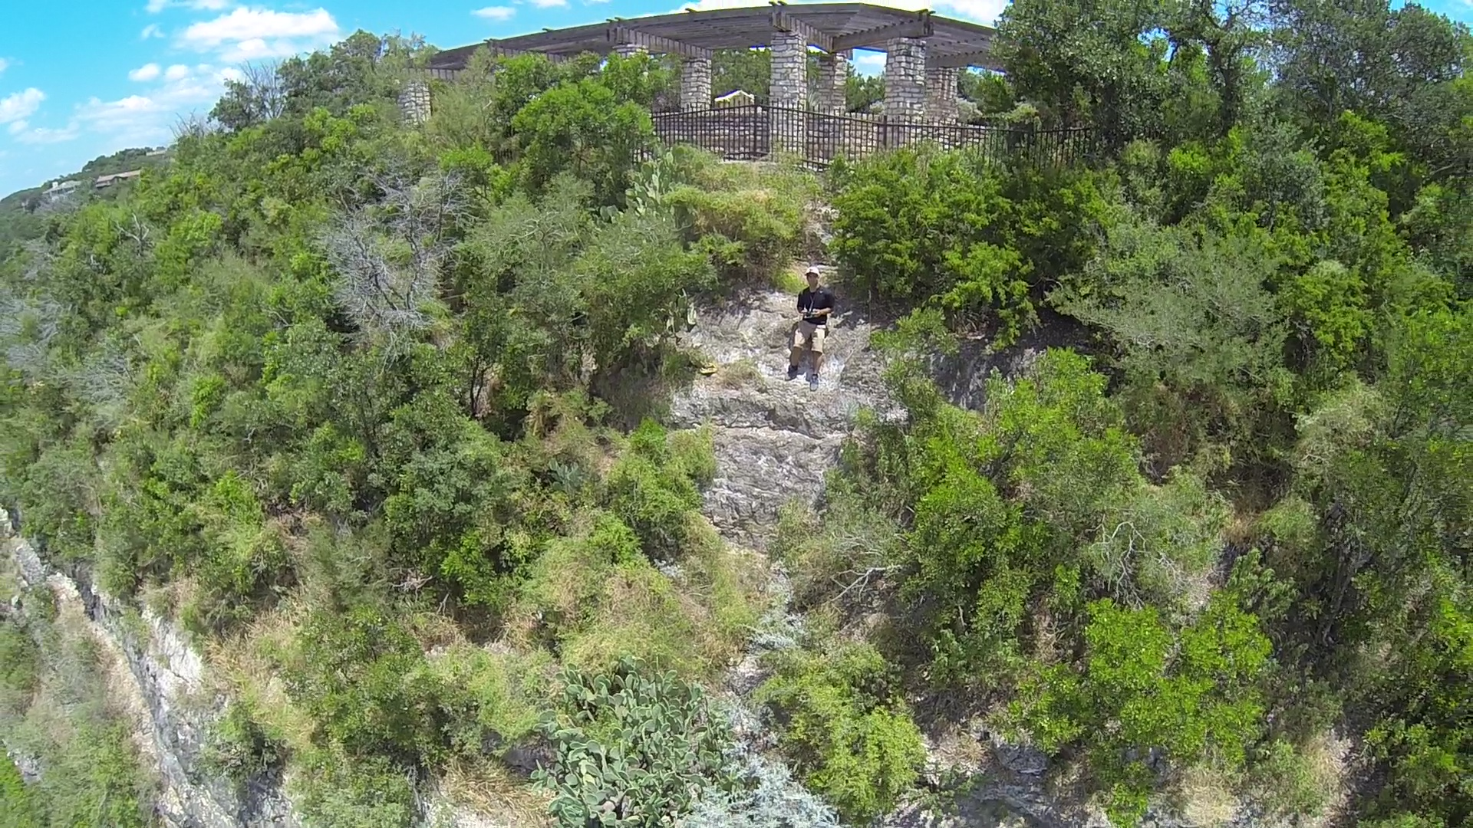
Site 4: Photosynth at Mount Bonnell
This walk photosynth consisted of 22 photographs.
Computational Photography @ GT

Slide 14
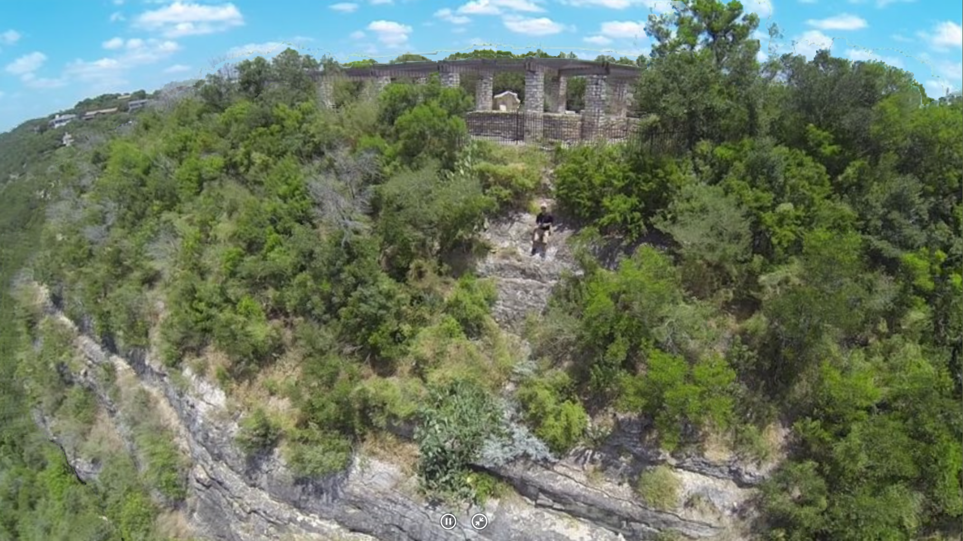
Site 4: Photosynth at Mount Bonnell
Photosynth 3D: https://photosynth.net/preview/view/44352e32-ef60-488e-a7d5-6632d61a8777
Computational Photography @ GT

Slide 15
Site 4: Details
This walk photosynth was generated using the Photosynth 3D preview. Rather than a “walk”, I took advantage of my drone’s stable gimbal-attached camera to create a flyby perspective. Commonly called a “dronie”, I flew the camera away from myself to reveal a larger, more majestic scene. This seemed to work well in the resulting photosynth as the cliff and trees provided depth.
What would you do differently?
Next time, I’d like to fly the camera even further out to reveal more of Mount Bonnell and the lake below.
Computational Photography @ GT

Slide 16
Any other details.
I had a lot of fun with this assignment, choosing the sites and planning how to showcase them with photosynths. When done right, photosynths add an immersive layer to 2-dimensional static images. I hope this medium of photography starts to catch on!
Computational Photography @ GT

